Slide 1

Enhancing Radiological Diagnoses through Pattern Imaging Analytics
Presented by : Llama Bots

Slide 2
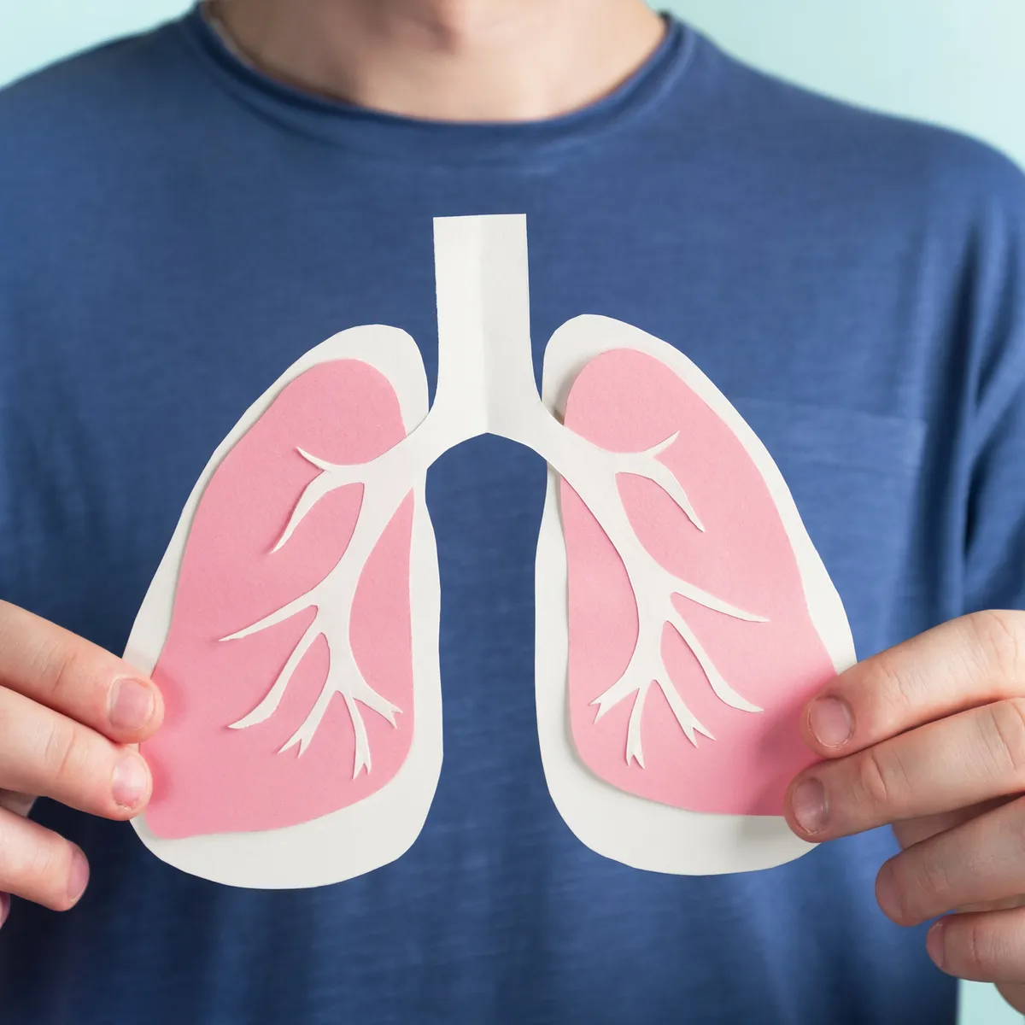
Problem definition
With this project, we aim to enhance radiological diagnoses through machine learning techniques, recognizing their pivotal role in healthcare and aiming to improve patient outcomes. We acknowledge the challenges of traditional radiological practices, including subjective interpretation and errors, and focus on developing pattern imaging analytics to enhance diagnostic accuracy and efficiency.
Data Overview: Source and Collection
1
Data Source
Our project utilizes a dataset sourced from the National Institutes of Health (NIH) Clinical Center.
The dataset comprises over 100,000 anonymized chest x-ray images from 30,000+ patients.
2
Data Details
Chest x-ray images were obtained from various medical facilities and curated to create a comprehensive dataset for research purposes.
3
Dataset Link https://nihcc.app.box.com/v/ChestXray-NIHCC/folder/36938765345

Slide 3
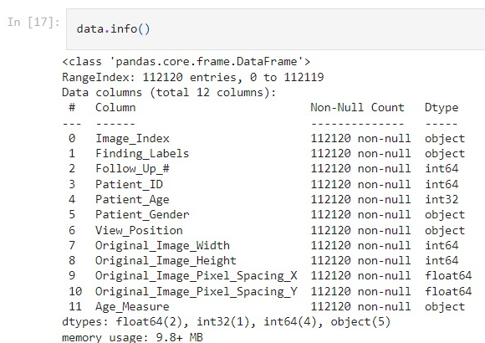
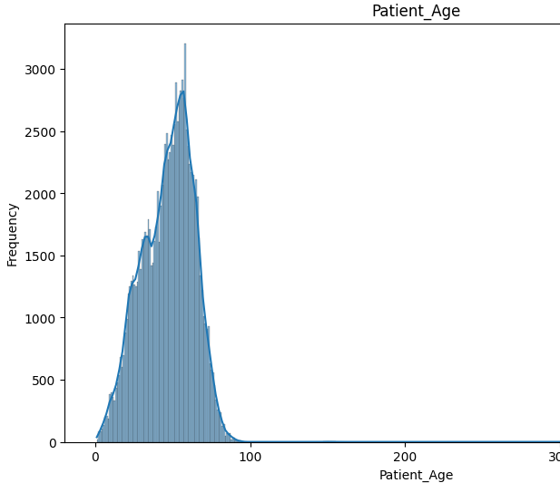
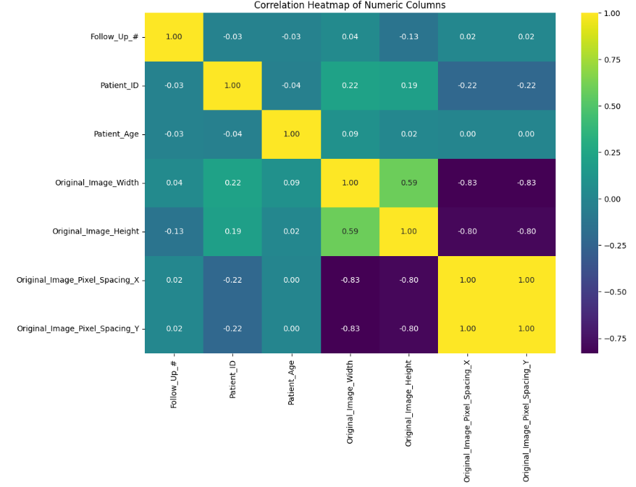
Exploratory Data Analysis (EDA) Insights
Initial Data Examination
Visualization and Outlier Detection
Relationship Analysis and Feature Selection
The dataset undergoes initial examination to assess basic characteristics, including checking for missing values, data types, and summary statistics to ensure data integrity and completeness.
Histograms and boxplots are employed to visualize numeric column distributions, with outliers detected using the Interquartile Range (IQR) method, enhancing data quality and robustness.
A correlation heatmap examines numeric column relationships, unnecessary columns are dropped based on relevance, and aggregation identifies key patterns, such as top patients with the highest number of visits, providing insights for subsequent modeling.
Notes:
The dataset undergoes initial examination to assess basic characteristics, including checking for missing values, data types, and summary statistics to ensure data integrity and completeness.Histograms and boxplots are employed to visualize numeric column distributions, with outliers detected using the Interquartile Range (IQR) method, enhancing data quality and robustness.Moving forward, a correlation heatmap examines numeric column relationships. Unnecessary columns are dropped based on relevance, and aggregation identifies key patterns, such as top patients with the highest number of visits, providing insights for subsequent modeling.Additionally, we normalize the pixel values of valid images by dividing each pixel value by 255.0, effectively rescaling them to a range between 0 and 1, a common preprocessing step for deep learning tasks involving image data.

Slide 4
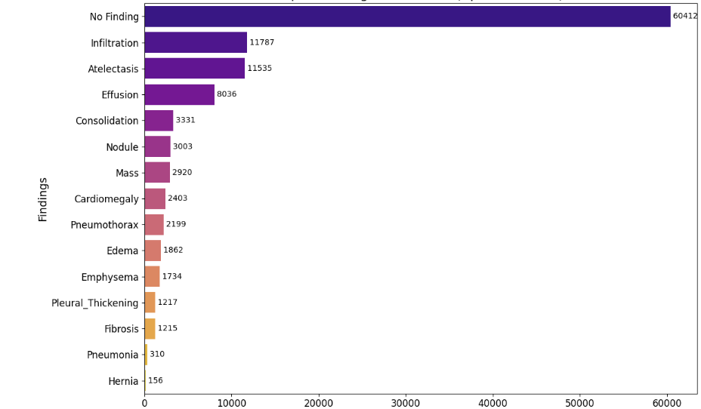
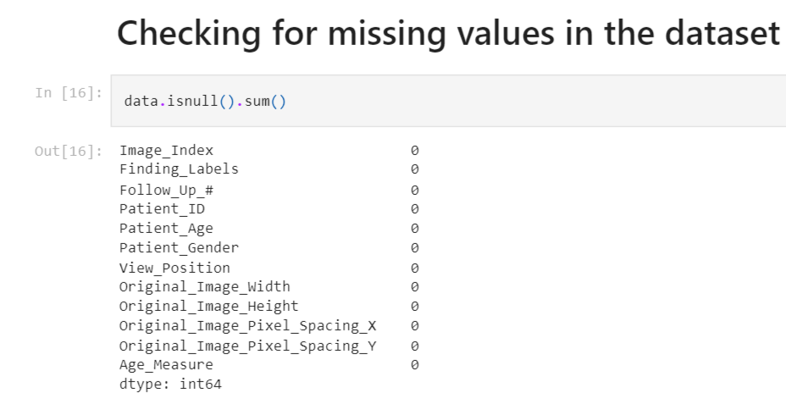
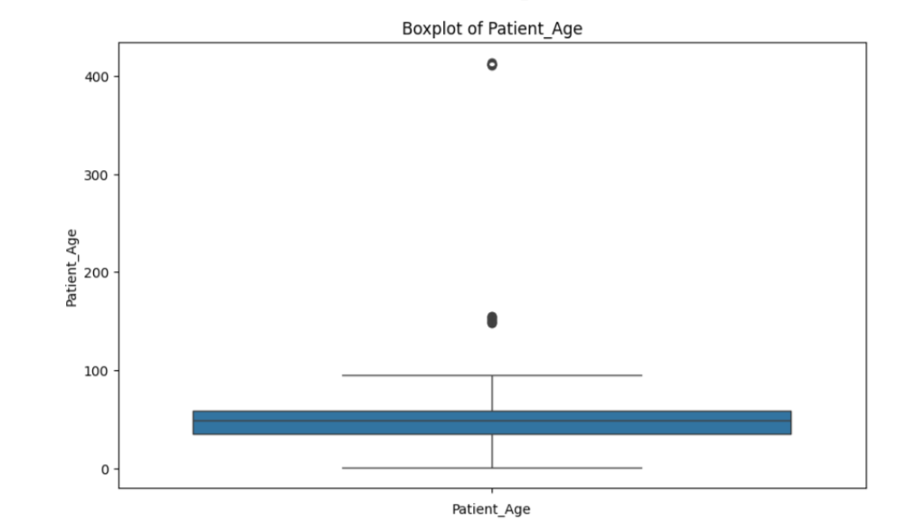
Data Observation
Presence of "No Finding" Label
Absence of Null Data
Negligible Outliers Detected
The dataset includes x-rays labeled as "No Finding," indicating instances where no detectable diseases are present, serving as examples of normal or healthy conditions.
Remarkably, there are no instances of null or missing data within the dataset, ensuring its completeness and reliability for subsequent analysis.
Notably, very few outliers were identified during the exploration, indicating the consistency and quality of recorded measurements and attributes.
Notes:
It's also worth noting that the dataset includes x-rays labeled as "No Finding," indicating instances where no detectable diseases are present, serving as examples of normal or healthy conditions. Remarkably, there are no instances of null or missing data within the dataset, ensuring its completeness and reliability. Notably, very few outliers were identified during the exploration, indicating the consistency and quality of recorded measurements and attributes.

Slide 5




Model Training and Evaluation
Dataset preprocessing
The labels were transformed to singular categories, reducing the original 709 categories to 15, following the lead of Stanford data scientists who adopted a similar label reduction approach.
Model Specification
Crafting CNN models featuring tanh, sigmoid, and ReLU activation functions alongside Convolution blocks of 3, 4, and 5, which double with each layer addition, while fine-tuning hyperparameters and architectural choices to maximize predictive accuracy and generalization.
Performance Metrics
Evaluating the model's sensitivity, specificity, overall diagnostic performance, and accuracy to comprehensively assess its effectiveness in medical image classification.

Slide 6

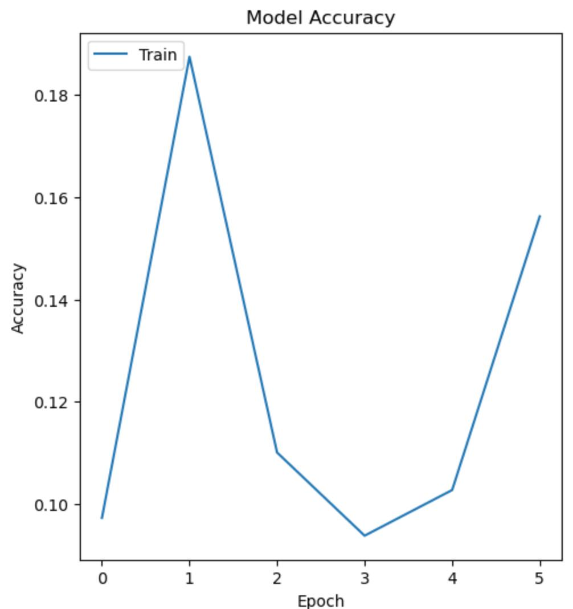
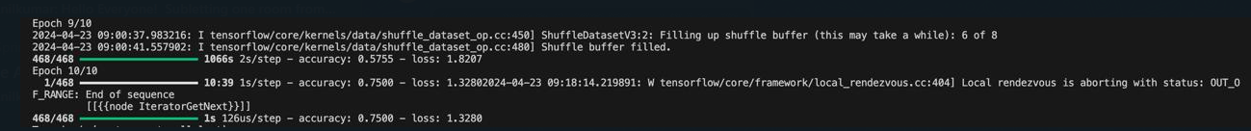
Key Findings and Results
The Convolutional Neural Network (CNN) model utilized in our project operates with two image sizes: 128x128 and 256x256.
The Convolutional Neural Network (CNN) model in our project employs three different activation functions: Sigmoid, ReLU and Tanh.
CNN model, featuring ReLU activation functions and operating on image sizes of 256x256 pixels, achieved an accuracy of 66%.
With 3 layers, the model has a relatively simpler architecture
Increasing the number of layers to 4 or 5 introduces additional depth and capacity to the model, enabling it to capture more intricate patterns and relationships within the data.
Challenges
Decreasing the number of images to 6000 resulted in a noticeable decline in accuracy, highlighting the importance of having a sufficient amount of data for training robust machine learning models.
Image Size
Activation function
Number of layers

Slide 7
Conclusion and Future Directions
1
Next Action Plan
With support from Surge, we anticipate running our model on an expanded dataset in the coming week, harnessing the capabilities of a superior GPU system.
2
Ongoing Research
Implementing large-scale, completely automated, accurate medical diagnostic systems is difficult. However, exploiting data-rich datasets such as ChestX-ray8 enhances deep neural network paradigms, allowing for the development of clinically relevant applications.
3
Transformative Potential
In conclusion, our experiment addresses a critical gap by creating a massive, machine-human annotated chest X-ray collection, similar to the benchmark "ImageNet" dataset. This resource captures real-world clinical and methodological difficulties, paving the path for improved diagnostic performance benchmarks in radiology.

